Slide 1
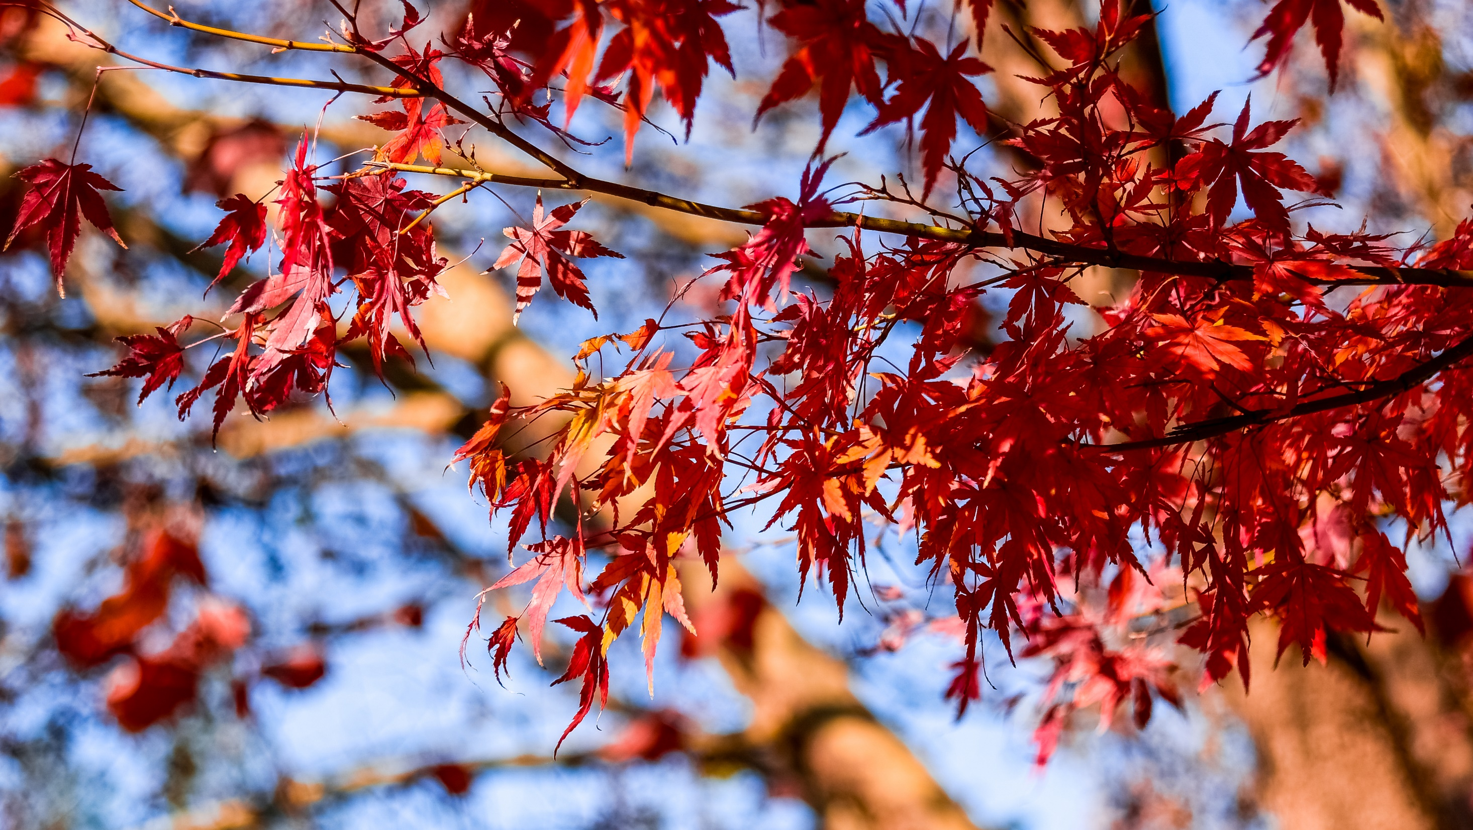

The Stair Sketch: Bringing more Clarity to Memorize Recent Events
ICDE’22, May 9–12, 2022, Virtual Event, Malaysia.
Yikai Zhao ∗ , Yubo Zhang ∗ , Pu Yi ∗ , Tong Yang ∗ , Bin Cui ∗ , Uhlig Steve†
∗Department of Computer Science, Peking University, China
† School of Electronic Engineering and Computer Science, Queen Mary University of London, United Kingdom
Notes:
Hello everyone, I'm Yikai Zhao from Peking University. My presentation today is about our paper “the stair sketch: bringing more clarity to memorize recent events”. Yubo Zhang is the co-first author of this paper.

Slide 2
Background
Streaming data analysis
Frequency estimation
Membership query
data stream
time
C
C
A
C
C
B
B
C
C
B
A
B
A
Notes:
The processing and analysis of streaming data are becoming more and more important. For a data stream consisting of many items, one may want to ask that whether a given item has appeared in the data stream, and what the frequency of that item is.

Slide 3



Background
Streaming data analysis : SKETCH ALGORITHMS
Frequency estimation: Count-Min sketch, Count sketch, CM-CU sketch, etc.
Membership query: Bloom Filter, etc.
data stream
time
C
C
A
C
C
B
B
C
C
B
A
B
A
sketch data structure
(e.g. Bloom Filter)
$hash_{1}$( )
$hash_{2}$( )
$hash_{3}$( )
A
A
A
 |  | 1 |  |  |  |  |  | 1 |  |  |  |  |  |  | 1
Notes:
Due to the high velocity and large volume of the data stream, it is difficult to accurately record the whole data stream. In recent years, a kind of hash-based probabilistic data structure, namely sketch, is more and more popular.
Sketch approximately records the data stream by maintaining a summary list. Typical sketch is composed of a counter array and several hash functions. The information of each item is recorded in several hashed counters.

Slide 4
Background
Typical method : hopping window (e.g. one hour)
1:00 PM
2:00 PM
3:00 PM
4:00 PM
5:00 PM
6:00 PM
C,1
C,1
A,2
C,2
C,3
B,3
B,4
C,5
C,5
B,1
A,3
B,5
A,5
window 1
window 2
window 3
window 4
window 5
Notes:
To record the data stream with finer granularity, people often use the hopping window model.

Slide 5
Background
Typical method : hopping window (e.g. one hour)
1:00 PM
2:00 PM
3:00 PM
4:00 PM
5:00 PM
6:00 PM
C,1
C,1
A,2
C,2
C,3
B,3
B,4
C,5
C,5
B,1
A,3
B,5
A,5
window 1
window 2
window 3
window 4
window 5
5:00 PM
sketch 1
sketch 2
sketch 3
sketch 4
Notes:
For example, we can divide the entire data stream into many time windows with the length of one hour, and create a sketch for each time window.

Slide 6
Background
Typical method : hopping window (e.g. one hour)
1:00 PM
2:00 PM
3:00 PM
4:00 PM
5:00 PM
6:00 PM
C,1
C,1
A,2
C,2
C,3
B,3
B,4
C,5
C,5
B,1
A,3
B,5
A,5
window 1
window 2
window 3
window 4
window 5
5:00 PM
sketch 1
sketch 2
sketch 3
sketch 4
delete
hold
hold
hold
create
6:00 PM
sketch 2
sketch 3
sketch 4
sketch 5
Notes:
Since the available memory is always limited, when a new time window starts, the naive approach is to delete the oldest sketch to release the memory for creating the new sketch.

Slide 7
Background
memorize recent events with higher accuracy
prior art – Hokusai
7:00 PM
window 7
window 6
window 5
window 4
window 3
window 2
window 1
Notes:
This approach can record the information of each time window fairly, but we find that people always pay more attention to the recent events, so they hope to record the events in the more recent time window with higher accuracy.
Hokusai algorithm is the only sketch algorithm to achieve this goal. It uses sketches of different sizes to record data streams in different time windows.

Slide 8
Background
memorize recent events with higher accuracy
prior art – Hokusai (imbalanced, inaccurate, time-consuming)
7:00 PM
8:00 PM
window 7
window 8
compress
window 6
window 7
hold
window 5
window 6
compress
window 4
window 5
hold
window 3
window 4
hold
window 2
window 3
hold
window 1
window 2
delete
Notes:
When a new time window arrives, Hokusai also needs to delete the oldest sketch, but it will also compress some sketches to release memory.

Slide 9
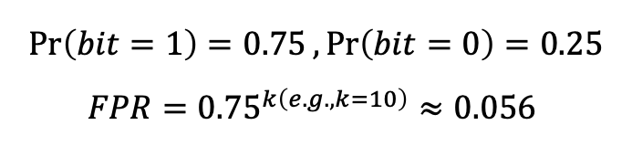
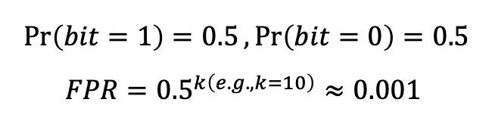

Background
memorize recent events with higher accuracy
prior art – Hokusai (imbalanced, inaccurate, time-consuming)
Inaccurate $\left(0.001→0.056\right)$
8:00 PM
1 | 0 | 1 | 0 | 0 | 1 | 1 | 0
window 8
$$\operatorname{Pr}\left(bit=1\right)=0.5, \operatorname{Pr}\left(bit=0\right)=0.5$$
$$FPR={0.5}^{k\left(e.g., k=10\right)}≈0.001$$
window 7
window 6
compress
window 5
1 | 1 | 1 | 0
window 4
$$\operatorname{Pr}\left(bit=1\right)=0.75, \operatorname{Pr}\left(bit=0\right)=0.25$$
$$FPR={0.75}^{k\left(e.g., k=10\right)}≈0.056$$
window 3
window 2
Notes:
Hokusai algorithm can be improved in some aspects, the most important of which is accuracy. Many sketches support compression, but compression often significantly reduces accuracy.
Taking Bloom Filter as an example, compressing an optimally configured Bloom Filter to half its size will increase its error by 50 times.

Slide 10




The Stair Sketch (Basic Version)
time window 1
time window 2
time window 3
time window 4
$$e, 1$$
$$e, 2$$
$$e, 3$$
$$e, 4$$
4
3
3
4
PHASE I
2
2
3
2
3
4
1
1
2
1
2
3
1
2
3
4
: ONE (1) Count-Min sketch / Count sketch / CM-CU sketch / Bloom filter
time
Notes:
I'll move on to introduce our proposed algorithm, the Stair sketch. Stair sketch is a generic data stream processing structure that can incorporate a variety of sketches including Bloom Filter and Count-Min sketch.
The key idea of stair sketch is to record data streams in more recent time windows with more sketches. Recording data streams in more sketches that use independent hash functions will result in higher accuracy.

Slide 11


The Stair Sketch (Basic Version)
time window 1
time window 2
time window 3
time window 4
$$e, 1$$
$$e, 2$$
$$e, 3$$
$$e, 4$$
4
3
3
4
PHASE I
2
2
3
2
3
4
1
1
2
1
2
3
1
2
3
4
: ONE (1) Count-Min sketch / Count sketch / CM-CU sketch / Bloom filter
time
time window 4
delete & re-initialize
time window 5
$$e, 4$$
4
4
5
$$e, 5$$
5
3
4
3
5
4
5
PHASE II
Re-initialize
2
3
4
2
5
3
4
5
1
2
3
4
1
5
2
3
4
5
Notes:
After the sketches we created use up the memory, for each new time window, we delete some sketches that record the old time window to release enough memory.

Slide 12
The Stair Sketch (Optimization)
8
8
7
8
Vertical
Sampling
7
8
6
7
8
5
6
7
8
5
6
7
8
1
2
3
4
5
6
7
8
4
5
6
7
8
3
4
5
6
7
8
2
3
4
5
6
7
8
1
2
3
4
5
6
7
8
Basic Version (8 windows)
Notes:
To make the Stair sketch more practical, we propose some optimizations.
The first is vertical sampling, and the key idea is that we don’t need to keep all the sketches, but only the sketches located in the layer numbered to the power of two. This optimization allows the Stair sketch to record more time windows.

Slide 13




The Stair Sketch (Optimization)
8
8
7
8
Vertical
Sampling
7
8
6
7
8
5
6
7
8
5
6
7
8
1
2
3
4
5
6
7
8
4
5
6
7
8
Horizontal Sharing
3
4
5
6
7
8
8
2
3
4
5
6
7
8
7
8
1
2
3
4
5
6
7
8
$$\left\langle 5, 6 \right\rangle$$
$$\left\langle 7, 8 \right\rangle$$
Basic Version (8 windows)
$$\left\langle 1, 2, 3, 4 \right\rangle$$
$$\left\langle 5, 6, 7, 8 \right\rangle$$
Notes:
The second optimization is horizontal sharing, and the key idea is that we only need to use two sketches in each layer. One sketch records the data stream in several old time windows, and the other sketch records the data stream in several new time windows.
This optimization is mainly for cases where the number of items varies dramatically over time windows.

Slide 14
















The Stair Sketch (Optimized Version)
time window 8
time window 9
8
9
7
8
8
9
$$\left\langle 5, 6 \right\rangle$$
$$\left\langle 7, 8 \right\rangle$$
$$\left\langle 7, 8 \right\rangle$$
$$\left\langle 9, − \right\rangle$$
$$\left\langle 1, 2, 3, 4 \right\rangle$$
$$\left\langle 5, 6, 7, 8 \right\rangle$$
$$\left\langle 5, 6, 7, 8 \right\rangle$$
$$\left\langle 9, −, −, − \right\rangle$$
time window 11
time window 10
11
10
10
11
9
10
$$\left\langle 9, 10 \right\rangle$$
$$\left\langle 11, − \right\rangle$$
$$\left\langle 7, 8 \right\rangle$$
$$\left\langle 9, 10 \right\rangle$$
$$\left\langle 5, 6, 7, 8 \right\rangle$$
$$\left\langle 9, 10, 11, − \right\rangle$$
$$\left\langle 5, 6, 7, 8 \right\rangle$$
$$\left\langle 9, 10, −, − \right\rangle$$
Notes:
As with the basic version, the optimized version of the Stair sketch also needs to delete some old sketches and create new ones when a new time window arrives. The detailed operation logic can be seen in our paper.

Slide 15
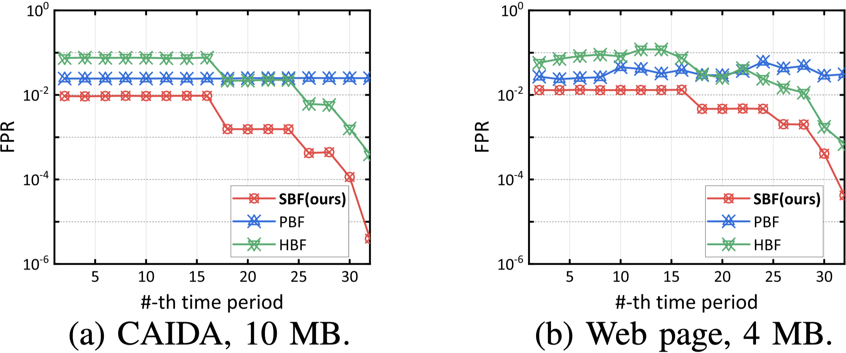
The Stair Sketch (Optimized Version)
time window 8
time window 9
8
9
7
8
8
9
$$\left\langle 5, 6 \right\rangle$$
$$\left\langle 7, 8 \right\rangle$$
$$\left\langle 7, 8 \right\rangle$$
$$\left\langle 9, − \right\rangle$$
$$\left\langle 1, 2, 3, 4 \right\rangle$$
$$\left\langle 5, 6, 7, 8 \right\rangle$$
$$\left\langle 5, 6, 7, 8 \right\rangle$$
$$\left\langle 9, −, −, − \right\rangle$$
time window 11
time window 10
11
10
10
11
9
10
$$\left\langle 9, 10 \right\rangle$$
$$\left\langle 11, − \right\rangle$$
$$\left\langle 7, 8 \right\rangle$$
$$\left\langle 9, 10 \right\rangle$$
$$\left\langle 5, 6, 7, 8 \right\rangle$$
$$\left\langle 9, 10, 11, − \right\rangle$$
$$\left\langle 5, 6, 7, 8 \right\rangle$$
$$\left\langle 9, 10, −, − \right\rangle$$
Notes:
Finally, due to the limited time, I only show one representative experimental result. This figure shows that the Stair sketch, like Hokusai algorithm, can record the more recent events more accurately, and its accuracy is one to two orders of magnitude higher than Hokusai algorithm.
Thank you. That's the end of my presentation.

